Slide 1
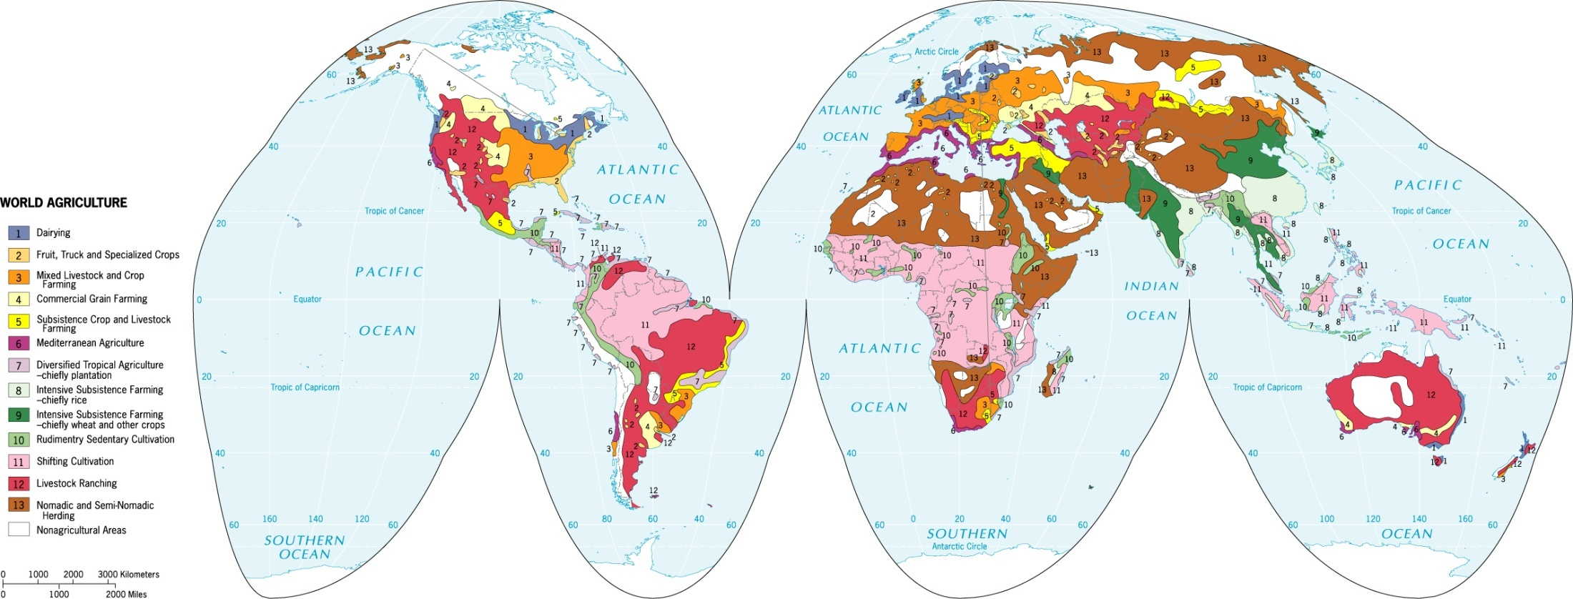
World Map of Agriculture
Cash Crop and Plantation Agriculture
Cotton and Rubber
Luxury Crops
Commercial Livestock, Fruit, and Grain Agriculture
Subsistence Agriculture
Mediterranean Agriculture
Illegal Drugs

