Slide 1
FRQISH
WHAT DO WE NEED TO KNOW FOR THE AP EXAM?

Slide 2
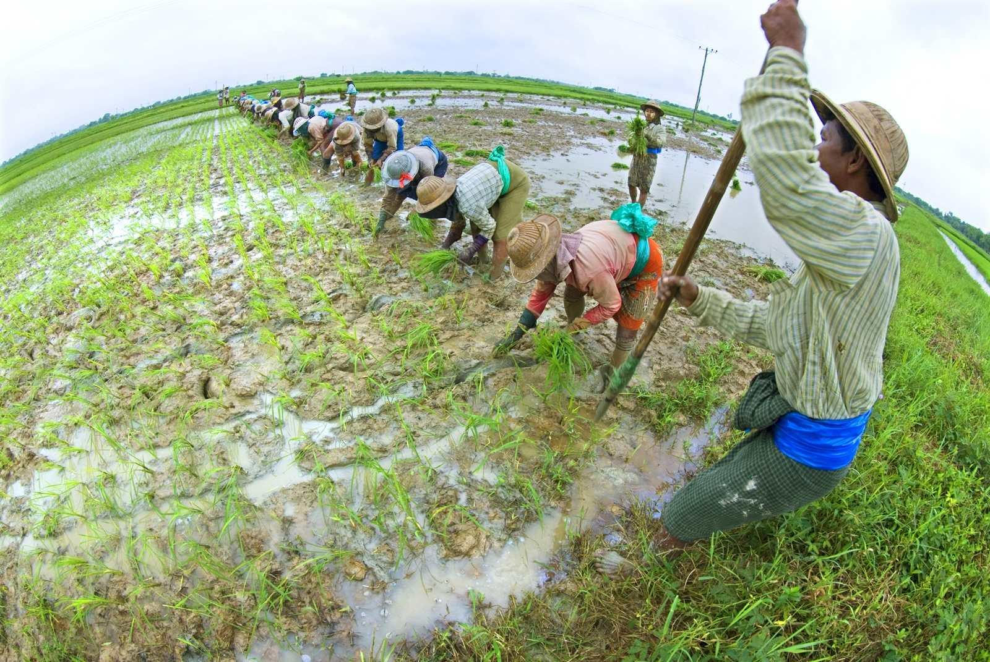
#1 LIST 5 CHARACTERISTICS OF THE GREEN REVOLUTION.

Slide 3
HIGH YIELD GMO RICE PESTICIDES/FERTILIZER/IRRIGATION HORMONES

Slide 4
#2 LIST 5 CRITICISMS OF THE GREEN REVOLUTION.

Slide 5
1. DID NOT HELP PERIPHERY/AFRICA/TOO MUCH $ 2. HEALTH CONCERNS (GMO/HORMONES 3. ENVIRONMENTAL- RUN OFF/ WATER SHORTAGES 4. SUPER PESTS 5. LOSS OF BIODIVERSITY

Slide 6
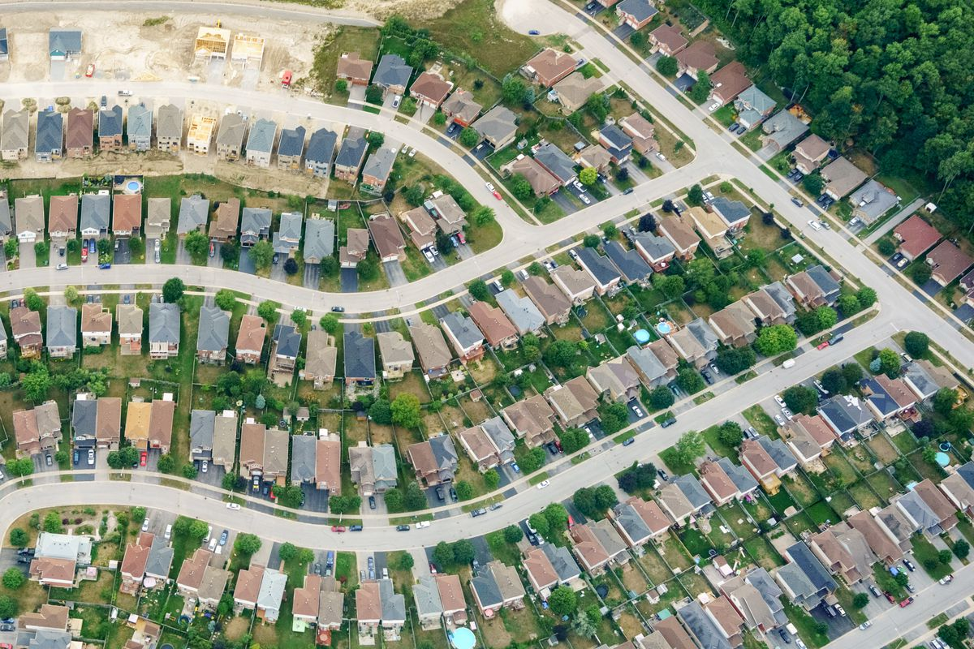
#3 WHAT 2 THINGS LED TO SUBURBANIZATION?

Slide 7
FREEWAYS/ACCESSIBILITY AFFORDABLE CARS (MIDDLE CLASS)

Slide 8
#4 LIST 3 REASONS PEOPLE MOVE TO SUBURBS.

Slide 9
CHEAPER/MORE LAND LESS CRIME PARKS/BETTER SCHOOLS

Slide 10
#5 LIST 2 NEGATIVES EFFECTS OF SUBURBANIZATION.

Slide 11
TAKES TAX $ FROM INNER CITY CAUSES URBAN DECAY

Slide 12
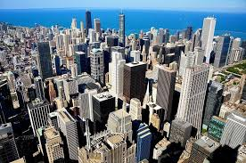
#6 WHAT 2 DEMOGRAPHIC GROUPS ARE ATTRACTED TO LIVING NEAR CBD?

Slide 13
DINKS AND SINKS RETIRED

Slide 14
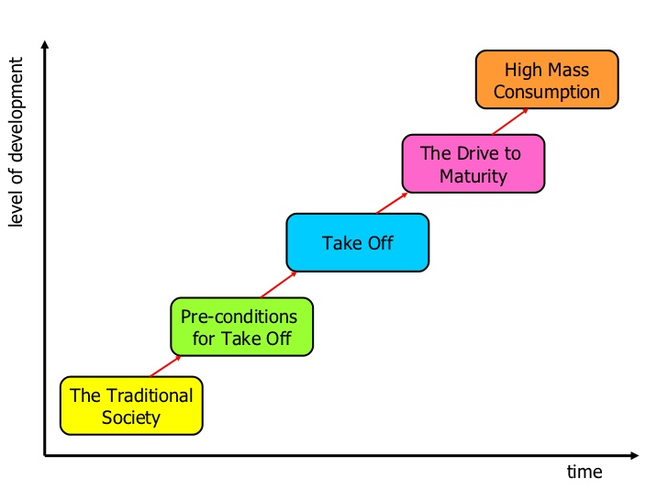
#7 LIST+ 1 CHARACTERISTIC – IN ORDER- ROSTOW’S STAGES OF ECONOMIC DEVELOPMENT.

Slide 15
*TRADITIONAL= DTM 2 *PRECONDITIONS FOR TAKEOFF= PERIPHERY/SUBSISTENCE/DTM 2 *TAKEOFF= URBANIZING/SECONDARY/ SEMI-PERIPHERY/DTM 3 *DRIVE TO MATURITY= CORE/DTM 4-5 * HIGH MASS CONSUMPTION= POST INDUSTRIAL/ CORE/ DTM 4/5

Slide 16
#8 LIST 2 CHARACTERISTICS OF A NATION?

Slide 17
COMMON ETHNICITY CULTURAL HOMOGENEITY

Slide 18
#9 LIST 4 CHARACTERISTICS OF A STATE.

Slide 19
DEFINED BORDERS SOVEREIGNTY/GOVERNMENT PERMANENT POPULATION RECOGNIZED BY OTHER STATES

Slide 20
#10 LIST THE 4 EXAMPLES OF NATION-STATE.

Slide 21
JAPAN, DENMARK, ICELAND, POLAND, FRANCE

Slide 22
11. LIST THE 3 EXAMPLES OF BALKANIZATION.

Slide 23
YUGOSLAVIA, CZECHOSLOVAKIA, SUDAN

Slide 24
#12 FOR EACH RELIGION- HEARTH/SACRED SITE, BURIAL PRACTICES, ARCHITECTURE CHRISTIANITY ISLAM BUDDHISM HINDUISM

Slide 25
CHRISTIANITY- JERUSALEM, PARK LIKE CEMETERIES, CHURCHES ISLAM- MECCA, PARK LIKE CEMETERIES, MOSQUE HINDUISM- INDIA/GANGES RIVER- CREMATION/ TEMPLES BUDDHISM- INDIA- STUPAS- CREMATION

Slide 26
#13 LIST 3 TERMS THAT DESCRIBE HOW TOURISM HAS DIMINISHED REGIONAL LANDSCAPE DISTINCTIVENESS.

Slide 27
HOMOGENEITY UNIFORMITY PLACELESSNESS

Slide 28
#14 LIST 2 SPECIFIC EXAMPLES OF HOW TOURISM HAS DIMINISHED REGIONAL LANDSCAPE DISTINCTIVENESS.

Slide 29
HOTELS/FAST FOOD CHAINS/ INFRASTRUCTURE THEME PARKS/ RESORTS

Slide 30
#15 LIST 4 SPECIFIC EXAMPLES OF HOW TOURISM HAS ENHANCED REGIONAL LANDSCAPE DISTINCTIVENESS.

Slide 31
*MAINTAINING CULTURAL LANDSCAPES *PRESERVATION OF HISTORY BUILDINGS/SITES *SUSTAINING INDIGENOUS LIFESTYLES/CULTURE *PROMOTION OF EXOTIC SCENERY (ECOTOURISM- COSTA RICA

Slide 32
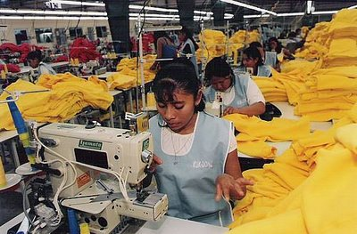
#16 LIST 3 CHARACTERISTICS/DESCRIPTIONS OF MAQUILADORAS

Slide 33
FOREIGN OWNED FACTORY IN MEXICO EXPORT PROCESSING ZONE TAKE ADVANTAGE OF CHEAP LABOR

Slide 34
#17 DESCRIBE THE SPATIAL DISTRIBUTION OF MAQUILADORAS WITHIN MEXICO.

Slide 35
NORTHERN MEXICO- NEAR BORDER CLOSE TO MAJOR USA CITIES/MARKETS (TRANSPORTATION COST)

Slide 36
#18 LIST 5 FACTORS THAT EXPLAIN WHY MNCS OUTSOURCE TO MEXICO.

Slide 37
*NAFTA *CHEAP LABOR *WEAK ENVIRONMENTAL REGULATIONS IN MEXICO *TAX INCENTIVES *EXPLOITATION OF LESS DEVELOPED COUNTRIES (CORE/PERIPHERY)

Slide 38
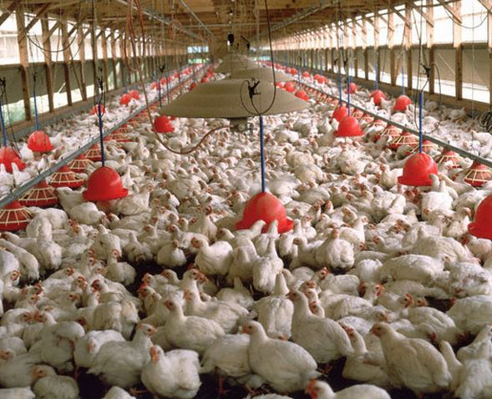
#19 LIST 3 CHARACTERISTICS OF POULTRY PRODUCTION IN THE UNITED STATES.

Slide 39
*LARGE SCALE *SPECIALIZED *FACTORY FARM/AGRIBUSINESS

Slide 40
#20 LIST 3 CHARACTERISTICS OF SUPRANATIONALISM.

Slide 41
*2 OR MORE COUNTRIES JOIN TO COMMON PURPOSE *POLITICAL, SOCIAL, ECONOMIC GOALS *STATES GIVE UP SOME SOVEREIGNTY

Slide 42
#21 LIST THE 3 EXAMPLES OF SUPRANATIONALISM.

Slide 43
*EUROPEAN UNION (EU) *NAFTA *UNITED NATIONS

Slide 44
#22 DESCRIBE DEVOLUTION.

Slide 45
*REGIONS DEMAND AND GAIN AUTONOMY FROM CENTRAL GOVERNMENT *MOVEMENT OF POWER FROM CENTRAL TO FEDERAL

Slide 46
#23 LIST 2 EXAMPLES OF DEVOLUTION.

Slide 47
UNITED KINGDOM CANADA (FRENCH QUEBEC) SPAIN (BASQUE, CATALONIANS) HAWAII

Slide 48
#24 LIST 5 CHANGES IN EUROPE AFTER EU.

Slide 49
*COMMON CURRENCY *OPEN BORDERS (LABOR AND TOURISTS) *LARGER MARKET/FREE TRADE *WAR LESS LIKELY *LOSS OF IDENTIFY/SOVEREIGNTY

Slide 50
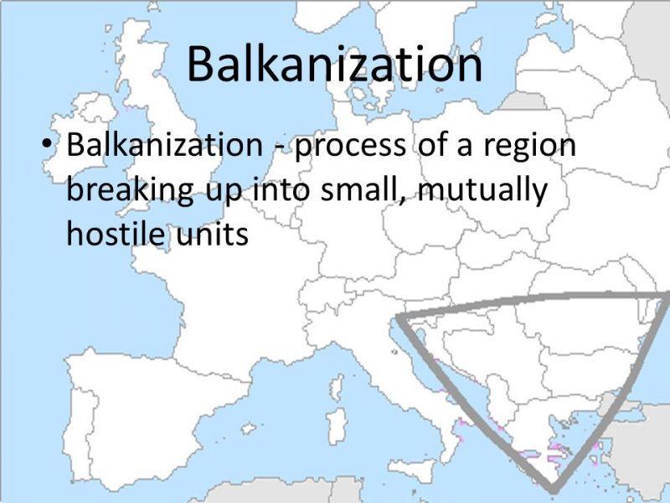
#25 LIST 3 EFFECTS OF BALKANIZATION.

Slide 51
FORMATION OF NEW STATES MASS MIGRATION ECONOMIC INSTABILITY

Slide 52
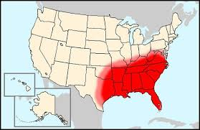
#26 LIST 4 REASONS A BUSINESS WOULD RELOCATE TO A SMALL SOUTHERN TOWN.

Slide 53
LOW WAGES LOW TAX STRUCTURE/TAX INCENTIVES LOW LAND/RENT COST NO UNIONS

Slide 54
#27 THE EXAMPLE OF FOOTLOOSE INDUSTRY.

Slide 55
CALL CENTER

Slide 56
#28 LIST 3 DISADVANTAGES IN THE USE OF CALL CENTERS AS A LOCAL ECONOMIC DEVELOPMENT STRATEGY.

Slide 57
LOW WAGE JOBS UNSTABLE EMPLOYER (FOOTLOOSE) LOW MULTIPLIER EFFECT FEW JOBS LOW SKILL

Slide 58
#29 DESCRIBE CENTRIPETAL FORCE.

Slide 59
UNIFIES STATE PROVIDES STABILITY STRENGTHENS STATE

Slide 60
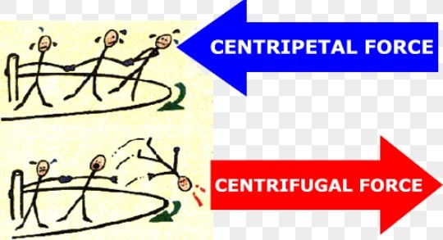
#30 LIST 6 EXAMPLES OF CENTRIPETAL FORCES.

Slide 61
SHARED RELIGION/LANGUAGE NATIONALISM STRONG ECONOMY COMPACT STATE INFRASTRUCTURE OUTSIDE THREAT/WAR

Slide 62
#31 DESCRIBE CENTRIFUGAL FORCE.

Slide 63
DIVIDES A STATE CAN LEAD TO BALKANIZATION WEAKENS A STATE

Slide 64
#32 LIST EXAMPLES OF A CENTRIFUGAL FORCE.

Slide 65
CULTURAL DIVERSITY FRAGMENTED/ELONGATED WAR (LASTS LONG TIME)

Slide 66
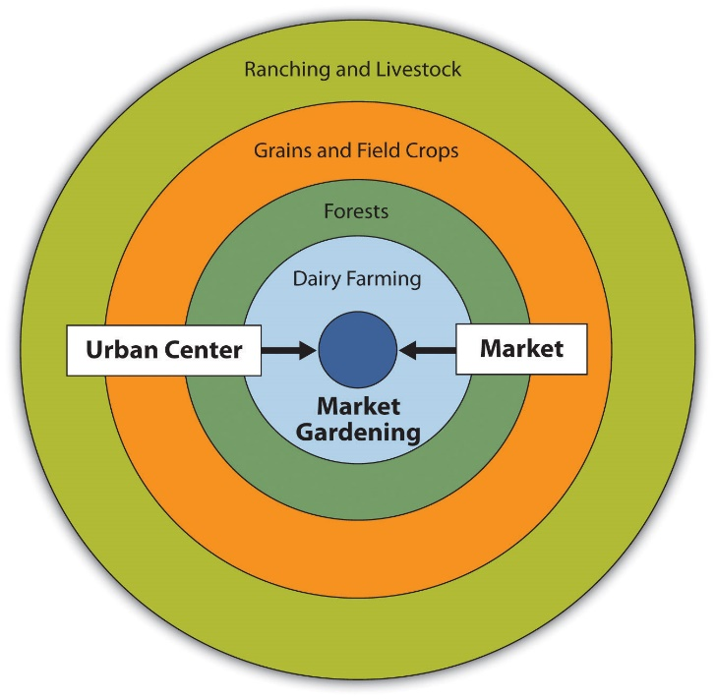
#33 LIST- IN ORDER- VON THUNEN LOCATION OF AGRICULTURAL ACTIVITIES.

Slide 67
MARKET DAIRY/MARKET GARDENING LUMBER GRAIN (EXTENSIVE) LIVESTOCK RANCHING (EXTENSIVE)

Slide 68
#34 LIST 4 CHARACTERISTICS OF DAIRY/MARKET GARDENING LOCATION.

Slide 69
INTENSIVE HIGHER LAND VALUES PERISHABLE GOODS ACCESSIBILITY TO MARKET

Slide 70
#35 LIST 3 CHARACTERISTICS OF GRAIN IN VON THUNEN.

Slide 71
EXTENSIVE LOWER LAND VALUE NOT PERISHABLE

Slide 72
#36 LIST 3 FACTORS THAT EXPLAIN WHY AGRICULTURE LAND USE PATTERN DIFFER FROM VON THUNEN’S TIME.

Slide 73
REFRIGERATED TRUCKS FOOD PRESERVATION IMPROVED TRANSPORTATION (FASTER) GLOBAL TRADE/ MARKET LUMBER NO LONGER NEEDED NEAR MARKET

Slide 74
#37 LIST 3 REASONS FOR LANGUAGE PRESERVATION/REVIVAL.

Slide 75
*MAINTAIN DISTINCT CULTURE *UNIFY MULTINATIONAL STATE *TOURISM (ATTRACT TOURISTS TO DISTINCTIVE LOCATION)

Slide 76
#38 LIST 5 CHARACTERISTICS TO DESCRIBE THE NEW INTERNATIONAL DIVISION OF LABOR.

Slide 77
COMPARATIVE ADVANTAGE OUTSOURCING GLOBALIZATION TRADE AGREEMENTS (NAFTA)

Slide 78
#39 LIST 4 IMPACT OF THE NEW INTERNATIONAL DIVISION OF LABOR ON THE SOCIOECONOMIC STRUCTURE OF THE UNITED STATES.

Slide 79
REGIONAL UNEMPLOYMENT (RUSTBELT) DEINDUSTRIALIZATION INCREASED PROFIT INTERNAL MIGRATION (FROM RUSTBELT TO SUNBELT)

Slide 80
#40 LIST 4 IMPACTS OF THE NEW INTERNATIONAL DIVISION OF LABOR ON THE SOCIOECONOMIC STRUCTURE OF DEVELOPING COUNTRIES (MEXICO/CHINA).

Slide 81
MORE JOB OPPORTUNITIES MORE WOMEN IN THE WORKFORCE INTERNAL MIGRATION ENVIRONMENTAL POLLUTION

Slide 82
#41 LIST 5 ASSUMPTIONS SHARED BY VON THUNEN AND CONCENTRIC ZONE.

Slide 83
*FLAT/UNIFORM LAND/FEATURELESS *IMPORTANCE OF CENTRALITY *PROFIT MAXIMIZATION *TRANSPORTATION COSTS ARE PROPORTIONAL TO DISTANCE IN ALL DIRECTION *THERE IS ONE SINGLE MARKET/CBD (ISOLATED STATE)

Slide 84
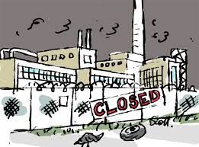
#42 4 TERMS TO DESCRIBE THE CAUSE OF OUT MIGRATION FROM USA NORTHEAST.

Slide 85
*DEINDUSTRIALIZATION *OUTSOURCING *RUST BELT REGIONAL UNEMPLOYMENT *GLOBAL DIVISION OF LABOR

Slide 86
#43 LIST 5 FACTORS THAT LOWER TFR.

Slide 87
WOMEN’S RIGHTS/EDUCATION INDUSTRIALIZATION URBANIZATION ACCESS TO BIRTH CONTROL DELAYED MARRIAGE

Slide 88
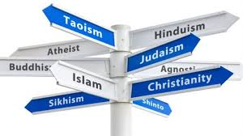
#44 MATCH REGION WITH RELIGION SOUTH= UTAH =

Slide 89
SOUTH= BAPTIST UTAH = MORMON

Slide 90
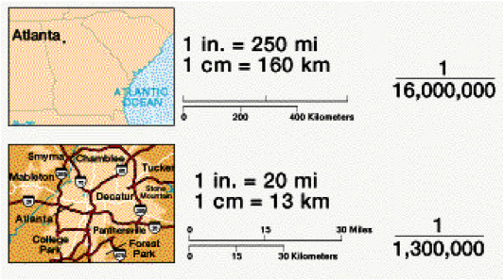
#45 DESCRIBE THE DIFFERENCE BETWEEN LARGE AND SMALL SCALE MAPS.

Slide 91
SMALL SCALE SHOWS LARGE AREA (GLOBE) LARGE SCALE SHOWS SMALL AREA (CITY)

Slide 92
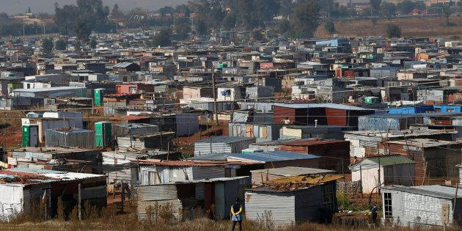
#46 LIST 2 CHARACTERISTICS DESCRIBING THE LOCATION OF SQUATTER SETTLEMENTS IN THE MEGACITIES OF THE PERIPHERY.

Slide 93
EDGE OF CITY VACANT/UNDESIRABLE LAND LAND WITH UNCLEAR TITLE

Slide 94
#47 LIST 3 FACTORS THAT CONTRIBUTE TO THE FORMATION OF SQUATTER SETTLEMENTS.

Slide 95
LARGE SCALE RURAL TO URBAN MIGRATION LACK OF AFFORDABLE HOUSING LACK OF OR LACK OF ENFORCEMENT OF ZONING LAWS

Slide 96
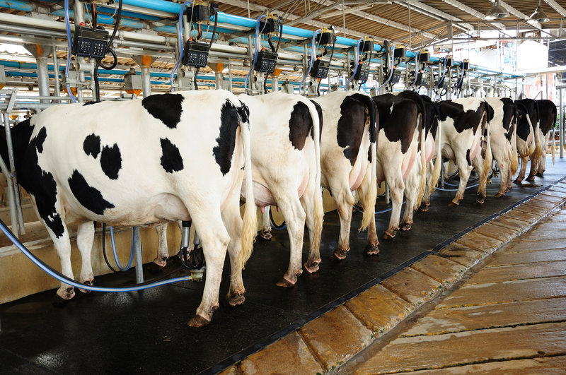
#48 LIST 4 FACTORS THAT HAVE CONTRIBUTED TO THE DECLINE OF THE NUMBER OF DAIRY FARMS IN THE UNITED STATES.

Slide 97
AGRIBUSINESS (ECONOMIES OF SCALE/FACTORY FARM) INCREASED MECHANIZATION INCREASED MILK PRODUCTION (HORMONES)

Slide 98
#49 LIST 5 REASONS USA CONSUMERS TURN TO ORGANIC.

Slide 99
HEALTH CONCERNS CAN AFFORD ORGANIC POPULAR CONCERN FOR TREATMENT OF ANIMALS ENVIRONMENTAL CONCERNS (CHEMICALS/FERTILIZERS)

Slide 100
#50 DESCRIBE + THE EXAMPLE WEIGHT/BULK GAINING INDUSTRY.

Slide 101
FINAL GOOD IS HEAVIER THAN INPUTS LOCATES CLOSE TO MARKET SODA BOTTLING

Slide 102
#51 DESCRIBE + THE EXAMPLE WEIGHT/BULK LOSING INDUSTRY.

Slide 103
INPUTS WEIGH MORE THAN FINISHED GOOD LOCATES CLOSE TO RAW MATERIALS PAPER MILL

Slide 104
#52 LIST THE 2 EXAMPLES OF FORWARD CAPITAL.

Slide 105
BRAZIL NIGERIA

Slide 106
#53 LIST 3 REASONS A STATE WOULD MOVE ITS CAPITAL.

Slide 107
BREAK TIES WITH COLONIAL PAST RETURN TO HISTORICALLY SIGNIFICANT AREA SPARK ECONOMIC GROWTH IN THAT AREA APPEASE DIVERSE POPULATION

Slide 108
#54 LIST 2 WAYS ETHNIC DIVERSITY CAN WEAKEN NATIONAL IDENTIFY.

Slide 109
SEPARATISM DEVOLUTION REGIONALISM ETHNONATIONALISM

Slide 110
#55 LIST 2 WAYS LACK OF TRANSPORTATION INFRASTRUCTURE CAN WEAKEN NATIONAL IDENTITY.

Slide 111
ISOLATION/SENSE OF SEPARATION FRICTION OF DISTANCE ECONOMIC DEVOLUTION

Slide 112
#56 LIST 5 CHARACTERISTICS OF A STAGE 2 COUNTRY.

Slide 113
HIGH BIRTH FALLING DEATH HIGH YOUTH DEPENDENCY RATIO PERIPHERY AGRARIAN/PRIMARY

Slide 114
#57 LIST 5 CHARACTERISTICS OF A STAGE 5 COUNTRY.

Slide 115
LOW BIRTH RATE LOW DEATH RATE AGING POPULATION/GRAYING POPULATION HIGH ELDERLY DEPENDENCY RATIO CORE POST INDUSTRIAL

Slide 116
#58 LIST 2 POSITIVE IMPACTS OF DTM 2 COUNTRY’S POPULATION ON ITS ECONOMIC DEVELOPMENT.

Slide 117
LARGE WORKFORCE LOW ELDERLY DEPENDENCY RATIO

Slide 118
#59 LIST 3 POSITIVE IMPACTS OF DTM 5 COUNTRY’S POPULATION OF ITS ECONOMIC DEVELOPMENT.

Slide 119
EDUCATED/SKILLED WORKFORCE LOW YOUTH DEPENDENCY RATIO MORE WOMEN IN FORMAL ECONOMY

Slide 120
#60 LIST 4 NEGATIVE IMPACTS OF DTM 2 COUNTRY’S POPULATION ON ITS ECONOMIC DEVELOPMENT.

Slide 121
HIGH YOUTH DEPENDENCY RATIO STRAIN ON RESOURCES/OVER CARRYING CAPACITY LOW LITERACY RATE/WOMEN WOMEN IN INFORMAL ECONOMY

Slide 122
#61 LIST 4 NEGATIVE IMPACTS OF DTM 5 COUNTRY’S POPULATION ON ITS ECONOMIC DEVELOPMENT.

Slide 123
HIGH ELDERLY DEPENDENCY RATIO FUTURE LABOR SHORTAGE TAX BURDEN/SOCIAL SECURITY NEED GUESTWORKERS

Slide 124
#62 LIST 2 CHARACTERISTICS OF A PRIMATE CITY.

Slide 125
MORE THAN 2X POPULATION OF NEXT LARGEST CITY EXERTS SOCIAL, POLITICAL, ECONOMIC DOMINANCE

Slide 126
#63 LIST THE 2 EXAMPLE OF PRIMATE CITY.

Slide 127
PARIS MEXICO CITY

Slide 128
#64 LIST 4 POSITIVE EFFECT OF PRIMATE CITIES ON A COUNTY’S ECONOMIC DEVELOPMENT.

Slide 129
AGGLOMERATION LARGE MARKET (CUSTOMER BASE) HIGH END GOODS AVAILABLE (THRESHOLD) GLOBAL TRADE/ATTRACT FDI

Slide 130
#65 LIST 4 NEGATIVE EFFECT OF PRIMATE CITIES ON A COUNTY’S ECONOMIC DEVELOPMENT.

Slide 131
UNEQUAL DEVELOPMENT UNEQUAL DISTRIBUTION OF WEALTH GOV FUNDS/INFRASTRUCTURE INVESTMENT CONCENTRATED IN ONE AREA- IGNORES OTHERS BRAIN DRAIN (INTERNAL MIGRATION)

Slide 132
#66 LIST 3 TERMS TO DESCRIBE MALTHUS CONCERNS ABOUT POPULATION GROWTH.

Slide 133
EXPONENTIAL/GEOMETRIC DTM 2 OVER CARRYING CAPACITY

Slide 134
#67 LIST 5 FACTORS THAT RESULT IN HIGH/INCREASED TFR.

Slide 135
LIMITED CONTRACEPTIVE USE AGRARIAN SOCIETY LACK OF WOMEN’S RIGHTS/EDUCATION CULTURE/EARLY MARRIAGE POPULATION POLICY (EXPANSIVE)

Slide 136
#68 LIST 5 FACTORS THAT HAVE INVALIDATED MALTHUS CLAIMS.

Slide 137
GREEN REVOLUTION LOWER TFR/ STAGE 5 AGRICULTURE TECHNOLOGY AGRIBUSINESS/ FACTORY FARMES GLOBAL TRADE

Slide 138
#69 LIST 2 FACTORS THAT VALIDATE NEOMALTHUSIANS.

Slide 139
PERIPHERY/STAGE 2 DESERTIFICATION/OVERGRAZING

Slide 140
#70 LIST 4 EXAMPLES OF WALLS OR BARRIERS BUILT BY COUNTRIES IN THE 20TH AND 21ST CENTURIES.

Slide 141
US- MEXICO WALL BERLIN WALL (EAST BERLIN- WEST BERLIN) NORTH KOREA-SOUTH KOREA DEMILITARIZED ZONE (DMZ) ISRAEL-PALESTINE/ WEST BANK- GAZA

Slide 142
#71 LIST 5 CHARACTERISTIC OF SUBSISTENCE AGRICULTURE.

Slide 143
CONSUMED ON THE FARM INFORMAL ECONOMY LOW TECHNOLOGY HIGH TFR (CHILDREN ARE AN ECONOMIC ASSET) HIGH AGRICULTURAL DENSITY

Slide 144
#72 DESCRIBE THE PRACTICE OF SLASH AND BURN (PROCESS).

Slide 145
1. CLEAR THE LAND (SLASH) 2. BURN THE LAND- ADDS NUTRIENTS TO SOIL 3. FARM THE LAND 4. LET THE LAND LAY FALLOW (YEARS OF NO FARMING) 5. RETURN TO START PROCESS OVER

Slide 146
#73 LIST 4 TERMS TO DESCRIBE BY SLASH AND BURN IN NOT IDEAL TODAY.

Slide 147
LOW CARRYING CAPACITY DTM 2 NOT SUSTAINABLE DEFORESTATION

Slide 148
#74 LIST 4 IMPACTS OF THE OF THE MUSLIM GUESTWORKERS ON THE RECEIVING COUNTRIES (FRANCE/GERMANY).

Slide 149
ETHNIC NEIGHBORHOOD/ETHNIC ENCLAVE CULTURAL LANDSCAPE HIGHER TFR INCREASED TENSIONS

Slide 150
#75 LIST 4 SPECIFIC REASONS FOR REDUCED FERTILITY IN THE CORE.

Slide 151
INCREASED EDUCATION OF WOMEN CHILDREN ARE AN ECONOMIC LIABILITY ACCESSIBLE BIRTH CONTROL/FAMILY PLANNING GOVERNMENT PENSION (NOT COUNTING ON CHILDREN)

Slide 152
#76 LIST 4 SPECIFIC REASON FOR INCREASED LIFE EXPECTANCY IN THE CORE.

Slide 153
IMPROVE HEALTHCARE IMPROVED LIFESTYLE (DIET/NUTRITION/EXERCISE) LESS CONFLICT (WAR) IMPROVED PUBLIC HEALTH (SANITATION/WATER)

Slide 154
#77 LIST 4 SOCIAL CONSEQUENCES THAT COUNTRIES FACE AS THEIR POPULATIONS AGE.

Slide 155
INCREASED GRAY POWER INCREASED IMMIGRATION (ETHNIC NEIGHBORHOODS) PRO-NATALIST POLICIES DECREASED YOUTH SERVICES (SCHOOLS) INCREASED ELDERLY SERVICES (BINGO)

Slide 156
#78 LIST 4 ECONOMIC CONSEQUENCES THAT COUNTRIES FACE AS THEIR POPULATIONS AGE.

Slide 157
HIGH ELDERLY DEPENDENCY RATIO INCREASED COSTS TO SOCIETY (PROGRAMS FOR ELDERLY) WORKER SHORTAGE

Slide 158
#79 LIST 4 CHARACTERISTICS OF ROSTOW MODEL.

Slide 159
*ASSUMES ALL COUNTRIES CAN FOLLOW SAME PATH TO DEVELOPMENT *BELIEVES THAT INTERNATIONAL TRADE MAY HELP COUNTRIES GROW ECONOMICALLY *LIBERAL MODEL *COUNTRY LEVEL ANALYSIS

Slide 160
#80 LIST 5 CHARACTERISTICS OF THE CORE PERIPHERY MODEL.

Slide 161
SAYS COUNTRIES ARE STATIC/STUCK EXPLOITIVE INTERNATIONAL TRADE STRENGTHENS CORE COUNTRIES STRUCTURALIST MODEL GLOBAL ANALYSIS

Slide 162
#81 LIST 5 CHARACTERISTICS /TERMS TO DESCRIBE SEMI-PERIPHERY.

Slide 163
TAKE-OFF DTM 3 MODERATE GROWTH SECONDARY ECONOMIC ACTIVITY URBANIZING

Slide 164
#82 LIST THE 4 EXAMPLES OF SEMI-PERIPHERY.

Slide 165
MEXICO CHINA INDIA BRAZIL/SOUTH AFRICA

Slide 166
#83 LIST 3 CHARACTERISTICS OF SUPERIMPOSED BOUNDARIES.

Slide 167
PLACED BY POWERFUL OUTSIDER IGNORES EXISTING CULTURAL BOUNDARIES BERLIN CONFERENCE

Slide 168
#84 LIST 5 CONSEQUENCES OF SUPERIMPOSED BOUNDARIES IN AFRICA.

Slide 169
CREATED MULTINATION STATES CAUSED CENTRIFUGAL/DEVOLUTIONARY FORCES CREATED LANDLOCKED STATES LOSS OF CULTURE CREATED MULTI-STATE NATIONS

Slide 170
#85 DESCRIBE THE PROCESS THAT CAN LEAD TO GERRYMANDERING.

Slide 171
CENSUS REAPPORTIONMENT REDISTRICTING MAYBE GERRYMANDERING

Slide 172
#86 PROVIDE A COMPLETE DEFINITION OF LINGUA FRANCA.

Slide 173
COMMON LANGUAGE USED BETWEEN COUNTRIES WITH DIFFERENT LANGUAGES

Slide 174
#87 SWAHILI IS THE LINGUA FRANCA IN ________ AFRICA.

Slide 175
EAST

Slide 176
#88 LIST 10 FACTORS THAT CONTRIBUTE TO THE WORLDWIDE USE OF ENGLISH.

Slide 177
COLONIALISM BY ENGLISH SPEAKING COUNTRIES FROM EUROPE RELIGION- SPREAD OF CHRISTIANITY/MISSIONARIES POPULAR CULTURE (ENGLISH DOMINATES) AVIATION INTERNET EDUCATIONAL OPPORTUNITIES INTERNATIONAL BUSINESS SUPRANATIONAL ORGANIZATION OFTEN USE ENGLISH (EU/UN) LANGUAGE OF ACADEMIA (SCIENCE RESEARCH WRITTEN IN ENGLISH) TOURISM- PLACE ACCOMMODATE ENGLISH SPEAKING TOURISTS

Slide 178
#89 LIST 5 REASON WHY REFUGEES LEAVE THEIR COUNTRY.

Slide 179
WAR POLITICAL PERSECUTION RELIGION PERSECUTION ETHNIC/RACIAL PERCEPTION/GENOCIDE NATURAL DISASTER

Slide 180
#90 LIST 3 NEGATIVE IMPACTS THAT REFUGEES CAN HAVE ON A RECEIVING COUNTRY.

Slide 181
COST TO PROVIDE SERVICES STRAIN ON NATURAL RESOURCES MAY POSE SECURITY RISK

Slide 182
#91 DEFINE + 3 EXAMPLES OF PRIMARY ECONOMIC ACTIVITY.

Slide 183
EXTRACTION OF RAW MATERIALS FARMING/FISHING/MINING/TIMBER

Slide 184
#92 LIST 4 TERMS ASSOCIATED WITH SECONDARY ECONOMIC ACTIVITY.

Slide 185
PROCESSING/ REFINING ASSEMBLY FACTORY INDUSTRIAL

Slide 186
#93 DEFINE + 4 EXAMPLES OF TERTIARY ECONOMIC ACTIVITY.

Slide 187
SERVICE TEACHER CONSTRUCTION WAITER

Slide 188
#94 LIST 3 REASONS FOR DECLINE IN PRIMARY SECTOR EMPLOYMENT AS A COUNTRY DEVELOPS OVER TIME.

Slide 189
TECHNOLOGICAL IMPROVEMENTS INDUSTRIALIZATION RURAL TO URBAN MIGRATION

Slide 190
#95 LIST 3 REASONS FOR DECREASES IN INFANT MORTALITY RATE AS A COUNTRY DEVELOPS OVER TIME.

Slide 191
IMPROVED HEALTHCARE (PRENATAL/INFANT VACCINES) IMPROVED SANITATION IMPROVED DIET

Slide 192
#96 DESCRIBE THE CENTRIFUGAL FORCE IN CANADA.

Slide 193
ETHNO CULTURAL DEVOLUTION FORCE- FRENCH

Slide 194
#97 LIST 2POSITIVE IMPACTS BILINGUALISM CAN HAVE ON A COUNTRY.

Slide 195
CULTURAL DIVERSITY ECONOMIC ADVANTAGES

Slide 196
#98 LIST 2 NEGATIVE IMPACT BILINGUALISM CAN HAVE ON A COUNTRY.

Slide 197
*CULTURAL TENSION (CENTRIFUGAL FORCE) *INCREASE COST FOR BILINGUAL -/ EDUCATION/ADVERTISEMENTS IN BOTH LANGUAGES

Slide 198
#99 LIST 5 CHARACTERISTICS OF COMMERCIAL AGRICULTURE.

Slide 199
HIGH TECHNOLOGY AGRIBUSINESS LARGE SCALE LOW AGRICULTURE DENSITY HIGH LEVELS OF CHEMICAL FERTILIZERS AND PESTICIDES

Slide 200
#100 SYNONYM FOR AGRIBUSINESS.

Slide 201
SUITCASE FARMING

